Slide 1


Slide 2


Control Structures
Control the flow of program

Slide 3

Control Structures
Two types :
Conditional Statements
Repetition Statements

Slide 4
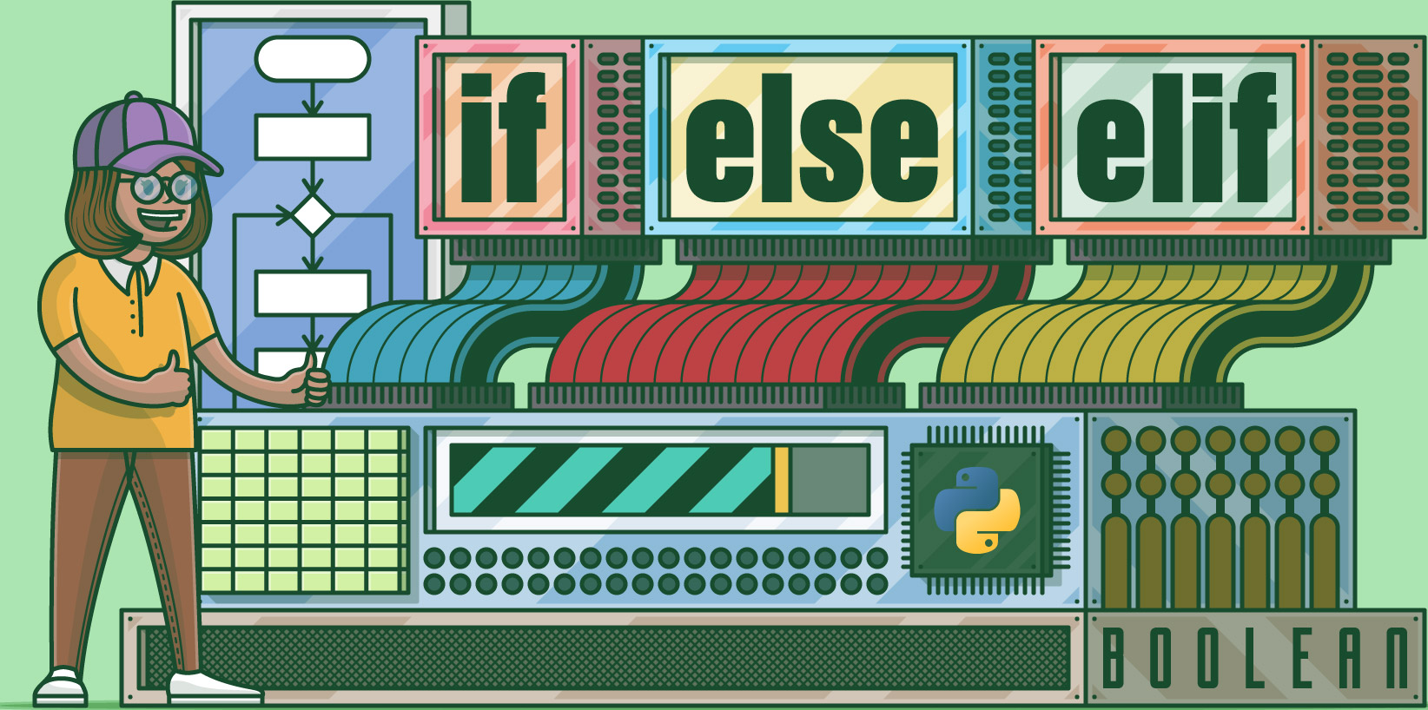
Conditional Statements
If statement
If - else statement
If - else if statement

Slide 5
Importance of Conditional Statements
Decision-making based on condition
Enables the program to take different paths
Provides control over the flow of program execution
Enhances logic and functionality

Slide 6
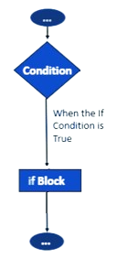
If Statement
Used for conditional execution, where a block of code is executed only if the given condition is true
Syntax :
if condition:
# Code block to execute if condition is true
Example :
age = 25
if age >= 18:
print("You are an adult.")

Slide 7

Give an example of If statement from daily life

Slide 8
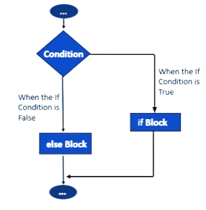
If-else Statement
Used for conditional execution, where a block of code is executed if the given condition is true, and another is executed if the condition is false
Syntax :
if condition:
# Code block to execute if condition is true
else
# Code block to execute if condition is false
Example :
age = 25
if age >= 18:
print("You are an adult")
else
print(“You are not adult”)

Slide 9
Give an example of If-else if statement from daily life

Slide 10
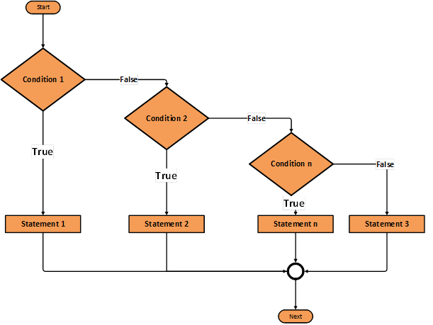
If-else if Statement
Used for conditional execution, where a block of code is executed if the given condition is true, and another is executed if the condition is false
Syntax :
if condition:
# Code block to execute if this condition is true
elif condition:
# Code block to execute if this condition is true
else
#code block to execute if all conditions are false
Example :
age = 25
if age > 18:
print("You are an adult")
elif age == 18:
print(“You will be adult soon”)
else
print(“You are not adult”)

Slide 11

Used to explain the code and make it more understandable
Ignored by the interpreter and are not executed as part of the program

Slide 12
Types of Comments
Single Line Comments
Multi Line Comments

Slide 13
Types of Comments
Single Line Comments
Start with a “#” character and continue until the end of that line
Multi Line Comments
By using triple quotes (’’’ or ‘’’’’’) at the beginning and end of the comment block

Slide 14

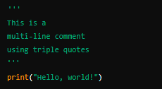
Types of Comments
Single Line Comments
Multi Line Comments

Slide 15
Write down comments of both types in proper format

Slide 16
HOME
Select an application of your own choice and write at least 2 from each
If
If-else
If-else if
statements which clarify their concept and working

